Slide 1
Flow Control

Slide 3
Flow And Error Control
The most important responsibilities of the data link layer are flow control and error control. Collectively, these functions are known as data link control.
Flow Control
Error Control

Slide 4
Flow control refers to a set of procedures used to restrict the amount of data
that the sender can send before
waiting for acknowledgment.
Error control in the data link layer is based on automatic repeat request (ARQ), which is the retransmission of data.

Slide 5
Protocols
Now let us see how the data link layer can combine framing, flow control, and error control to achieve the delivery of data from one node to another.
The protocols are normally implemented in software by using one of the common programming languages.

Slide 6
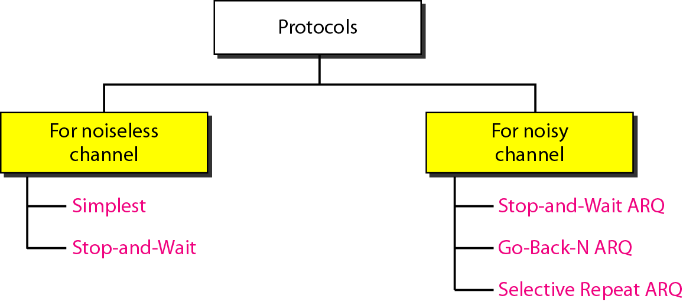
Taxonomy of protocols

Slide 7
Noiseless Channels
we have an ideal channel in which no frames are lost, duplicated, or corrupted.
Simplest Protocol – has no flow or error control
Stop-and-Wait Protocol – sender sends one frame, stops until it receives conformation from receiver and then sends the next frame

Slide 8
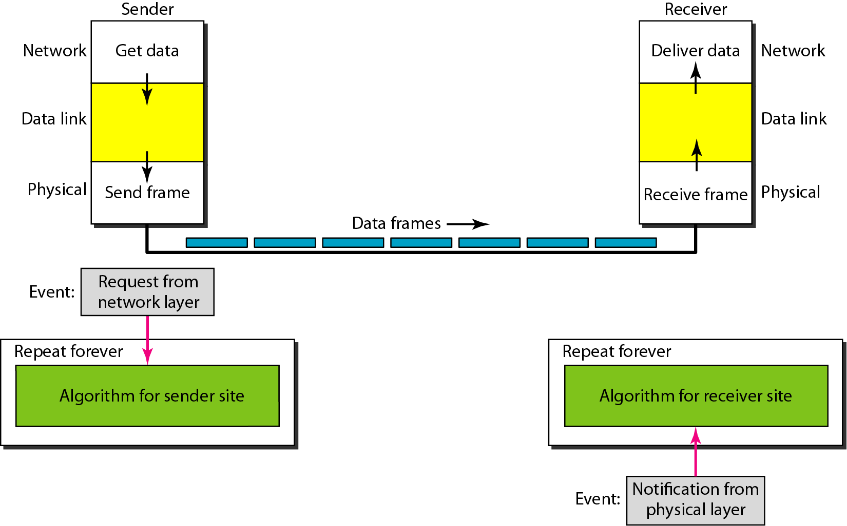
The design of the simplest protocol with no flow or error control

Slide 9
Acknowledgements & Timeouts

Slide 10
Stop-and-Wait
Simplest form of flow control.
How does it work? (assume error-free channel)
(1) Send 1 frame;
(2) Wait for ACK.
(3) Go to 1.

Slide 11
ARQ Protocols
Automatic Repeat Request.
Protocols that wait for ACK before sending more data.
ACKs now are used for flow AND error control.
What can happen?
At receiver: frame arrives correctly, frame arrives damaged, or frame does not arrive.
At sender: ACK arrives correctly, ACK arrives damaged, or ACK does not arrive.

Slide 12
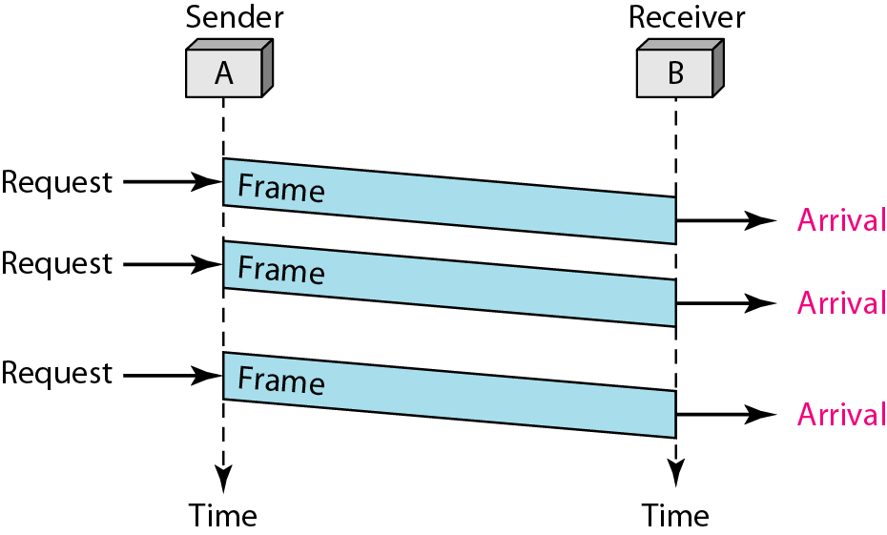
The sender sends a sequence of frames without even thinking about the receiver.
To send three frames, three events occur at the sender site and three events at the receiver site.
Note that the data frames are shown by tilted boxes; the height of the box defines the transmission time difference between the first bit and the last bit in the frame.

Slide 13
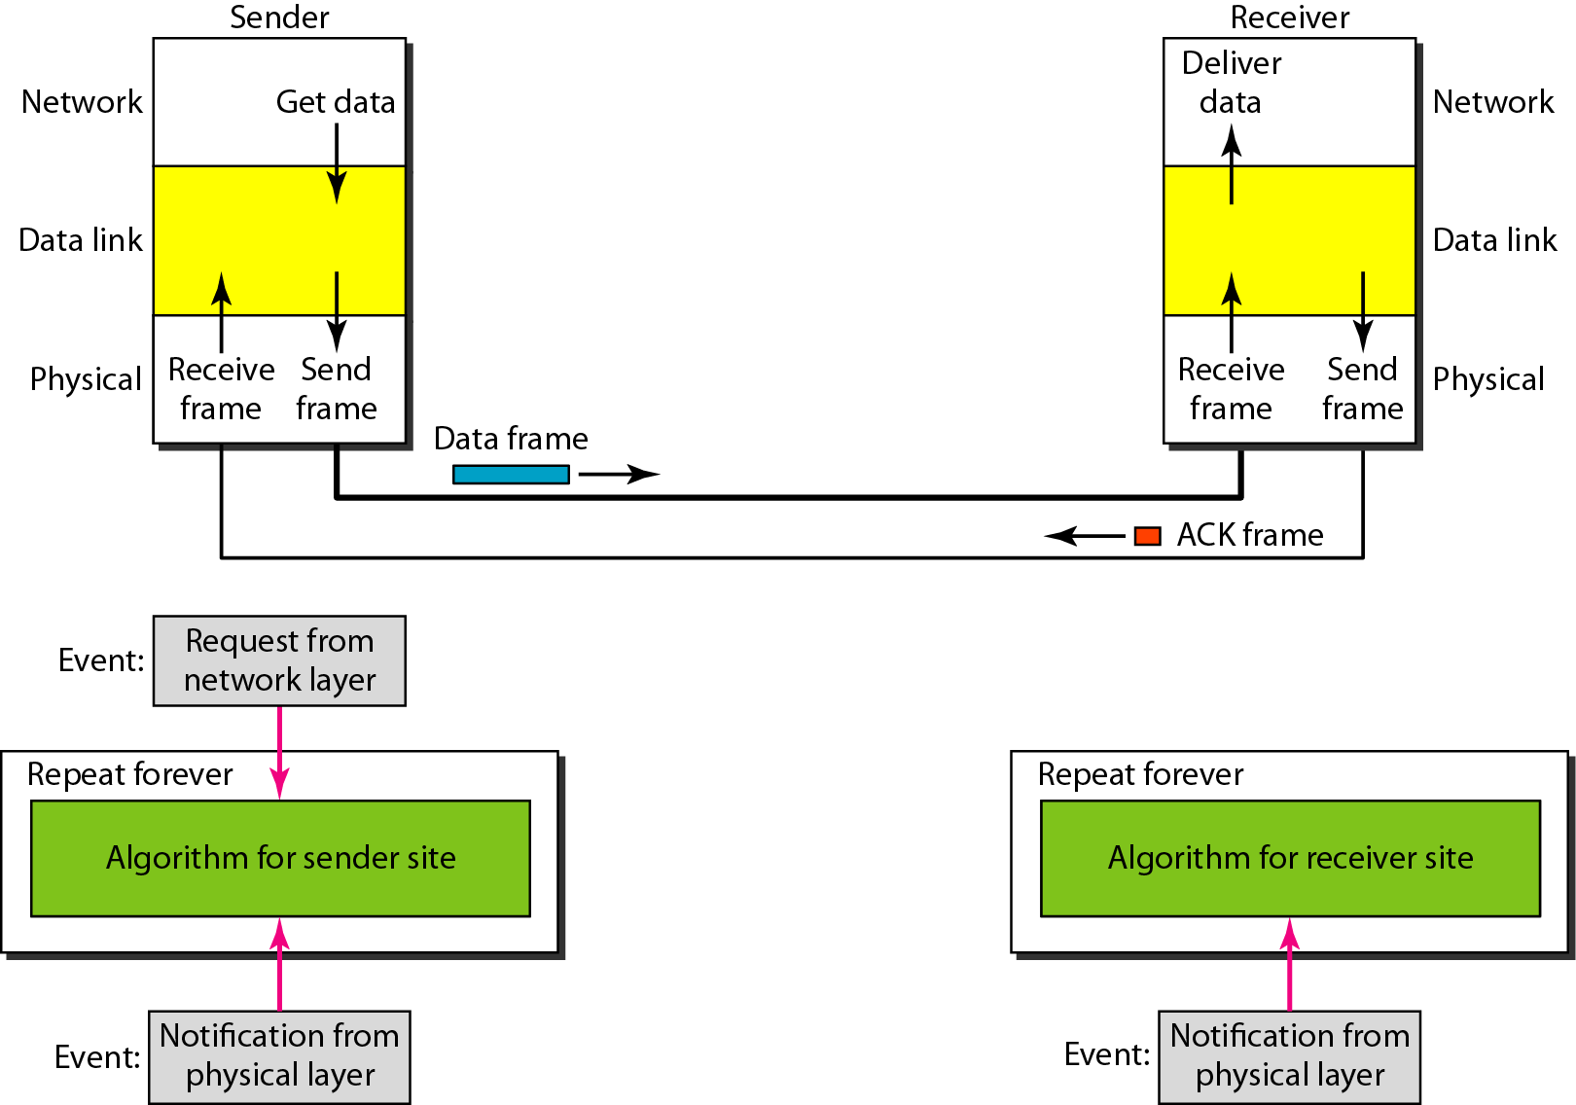
Design of Stop-and-Wait Protocol

Slide 14
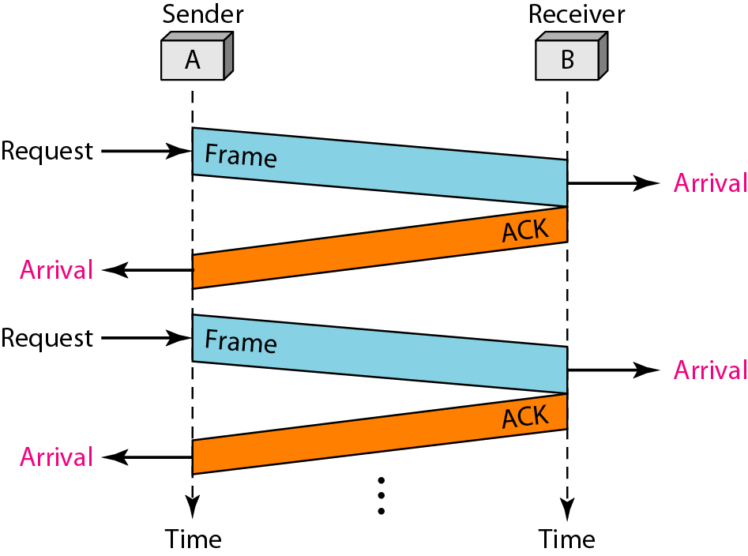
It is still very simple. The sender sends one frame and waits for feedback from the receiver.
When the ACK arrives, the sender sends the next frame.
Note that sending two frames in the protocol involves the sender in four events and the receiver in two events.

Slide 15
Stop-and-Wait
Very simple!
But, poor link utilization.
High data rates.
Long propagation delay.

Slide 16
Noisy Channels
Stop-and-Wait Automatic Repeat Request
Go-Back-N Automatic Repeat Request
Selective Repeat Automatic Repeat Request

Slide 17
Sequence number
If we use n bits to transmit receiver
Sequence number is 2 power n are possible
Range of sequence 0- 2 power n-1

Slide 18
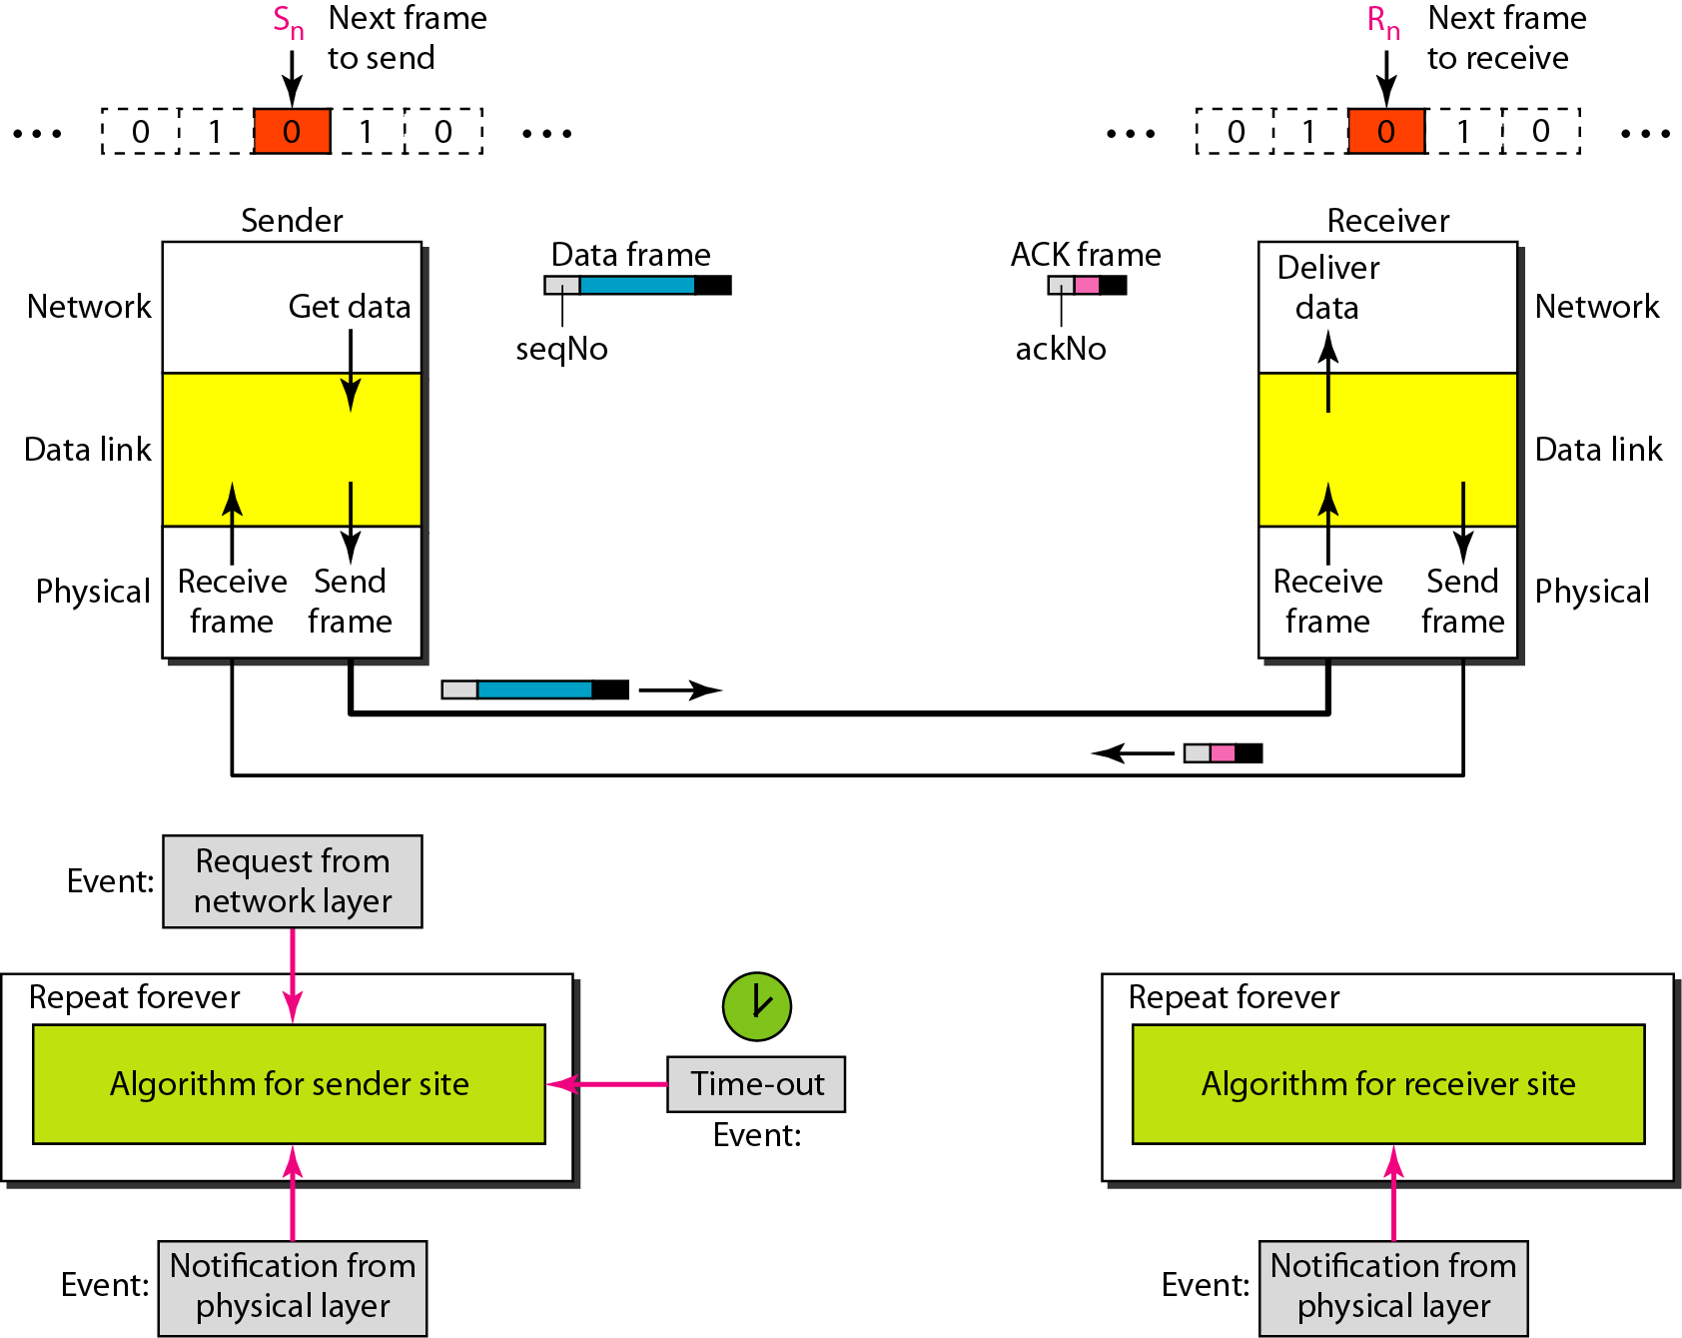
Design of the Stop-and-Wait ARQ Protocol

Slide 19
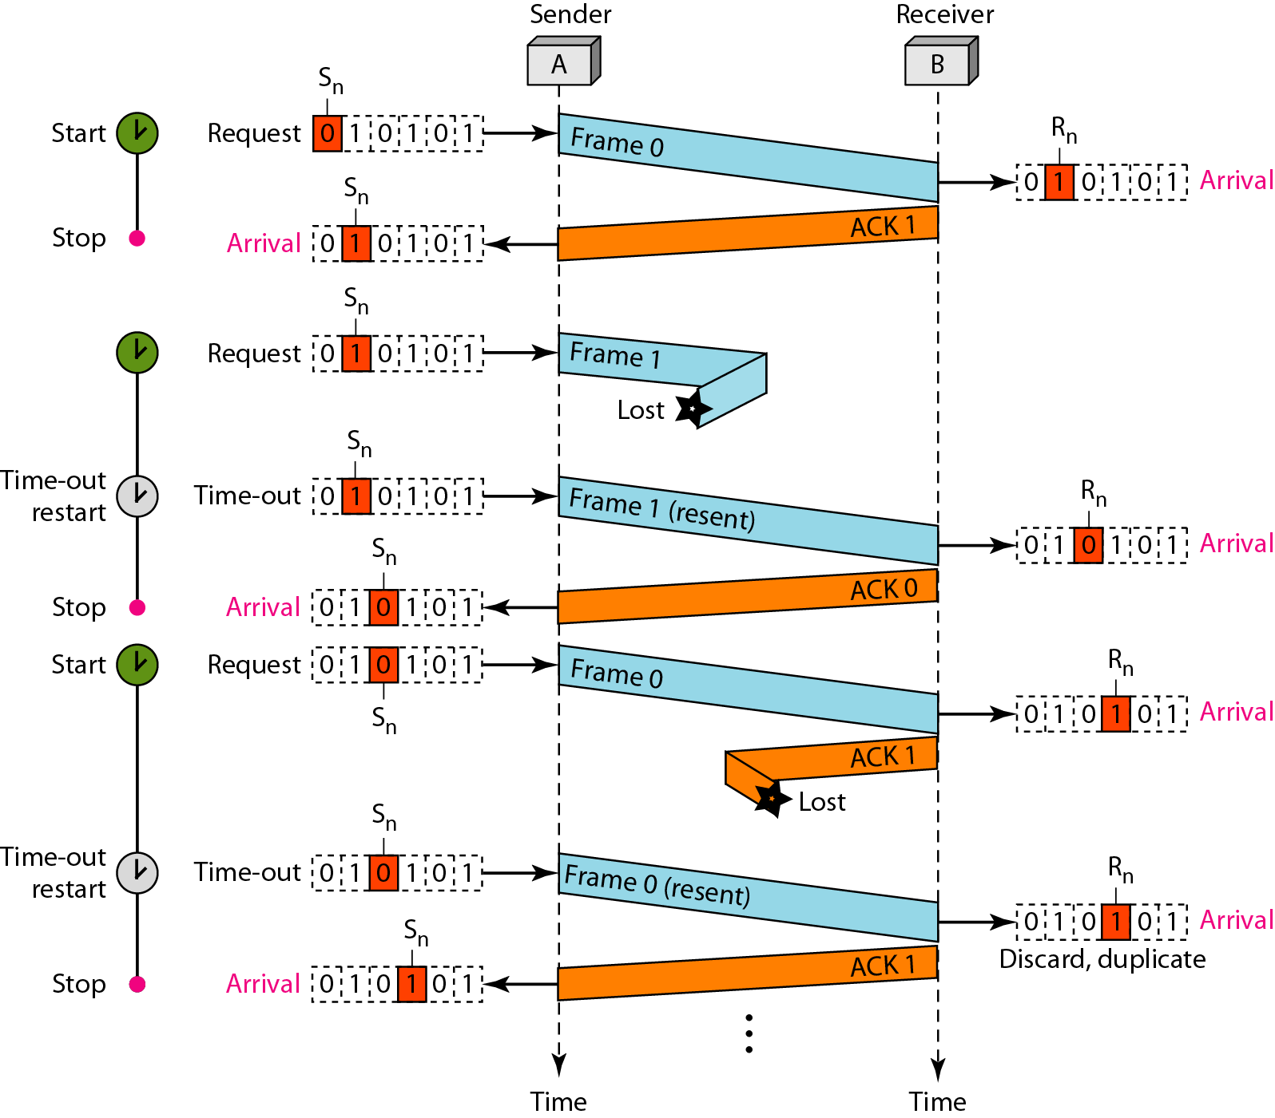
shows an example of Stop-and-Wait ARQ. Frame 0 is sent and acknowledged. Frame 1 is lost and resent after the time-out. The resent frame 1 is acknowledged and the timer stops.
Frame 0 is sent and acknowledged, but the acknowledgment is lost. The sender has no idea if the frame or the acknowledgment is lost, so after the time-out, it resends frame 0, which is acknowledged.

Slide 20
Stop –wait ARQ
Advantage
flow control
Error control
Disadvantage
Inefficient channel utilization
BW= 1mbps , delay = RTT – 20ms

